Slide 1


Use of YOLO for Text Detection
Assignment 5
Project Mentors :
Mrs. Priya R.L ,
Mrs. Nusrat Ansari
Group Number : 30
Group Members : J N Guru Akaash D17A 28
Ajay Nair D17A 55
Manigandhan K D17A 47
Varun Tripathy D17A 69

Slide 2
Content
Introduction to the Assignment
Methodology employed
Results and implementation screenshots
Conclusion

Slide 3
Introduction to the assignment
Task given
Solution Introduction

Slide 4
Introduction to the assignment
Task Given
To perform automatic Object Detection on the frames of videos of the Machine display captured from the mobile device/camera.
Solution Introduction
The main objective of this assignment is to perform Object Detection automatically on the given frames.
We will be trying to detect all the scene text which is detected in the frames automatically and give user the opportunity to select all the ROI the user is interested in.
We have implemented YOLO model as well as Keras model to implement the automatic object detection module.

Slide 5
Methodology employed
Implementation of YOLO v4 model, which is trained on the custom dataset.
This custom dataset is created using BBox annotation tool on the frames of the video dataset collected from our College Lab.
Two Implementations of YOLO Model one using the DarkNet architecture and the other using the MobileNet Architecture.
Creation of all the ROIs in the frame using EasyOCR.
Allowing the user to create his own ROI other then the ROIs created by the model, if required.

Slide 6
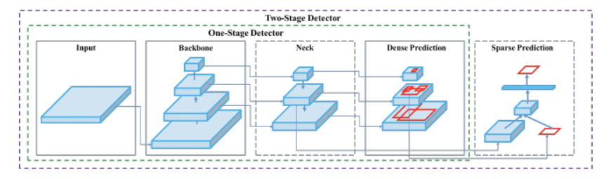
YOLO v4 Architecture

Slide 7
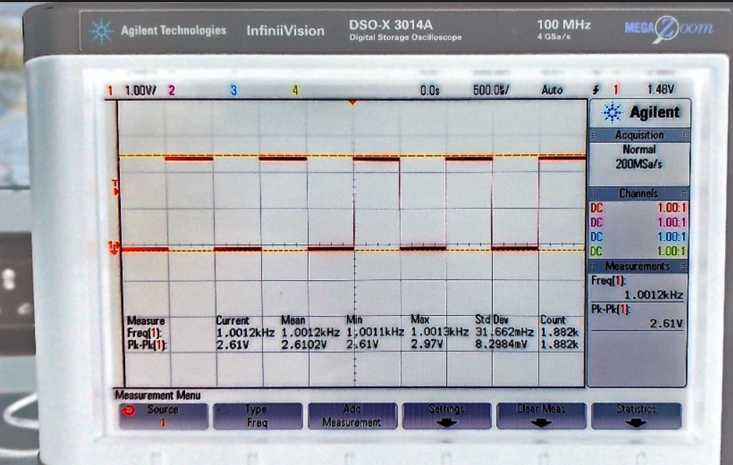
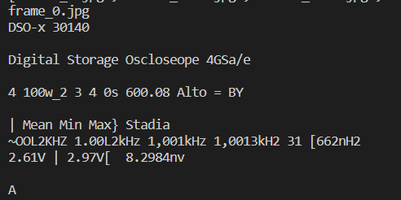
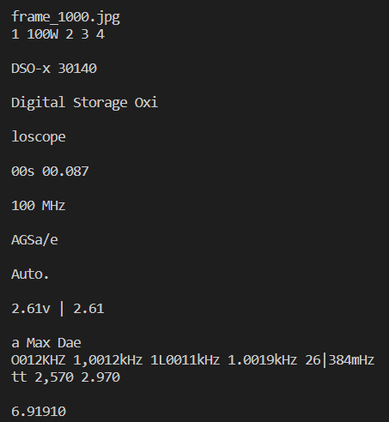
Results and implementation screenshots
OCR on entire frame
Frame
Tesseract OCR engine

Slide 8
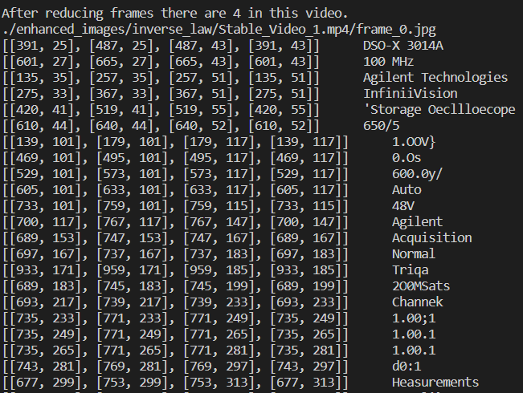
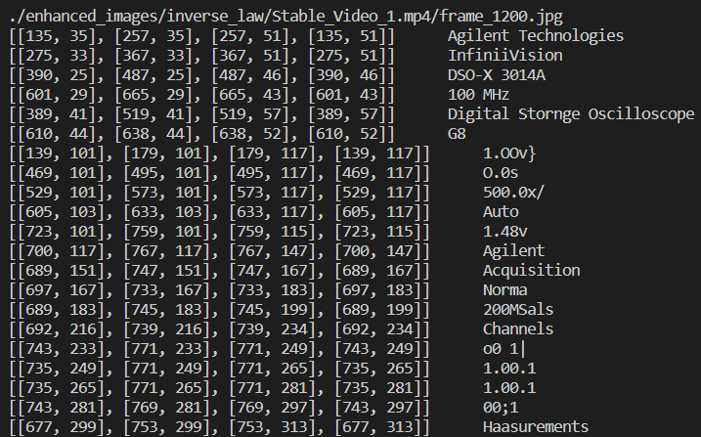
Results and implementation screenshots
EasyOCR results on an entire frame from the video feed

Slide 9
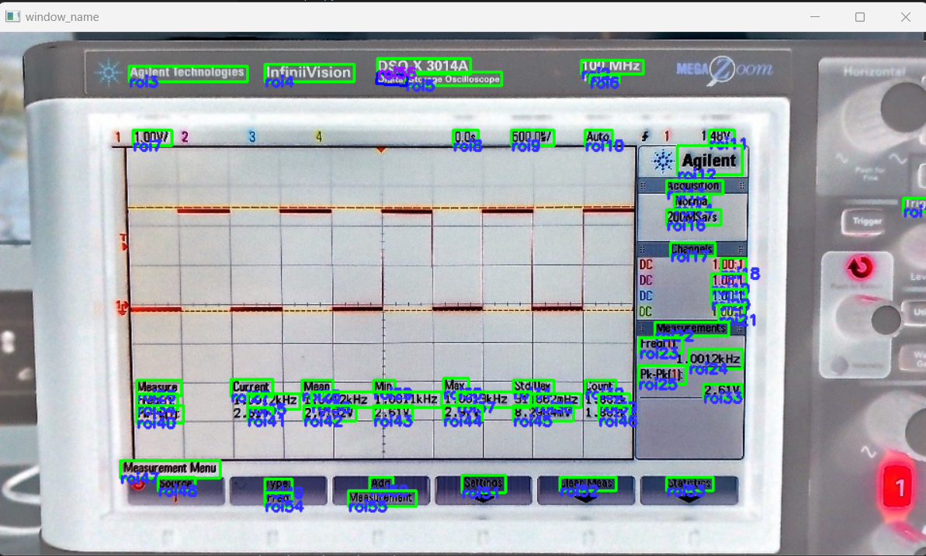
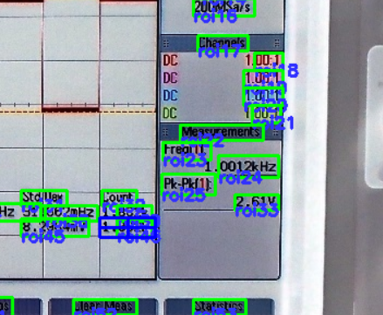
Results and implementation screenshots
ROI selection
Text Detection phase using EasyOCR

Slide 10
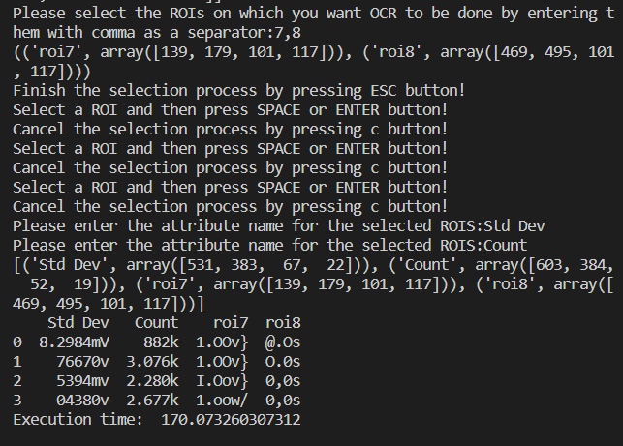
Results and implementation screenshots
Final OCR Result on EasyOCR

Slide 11
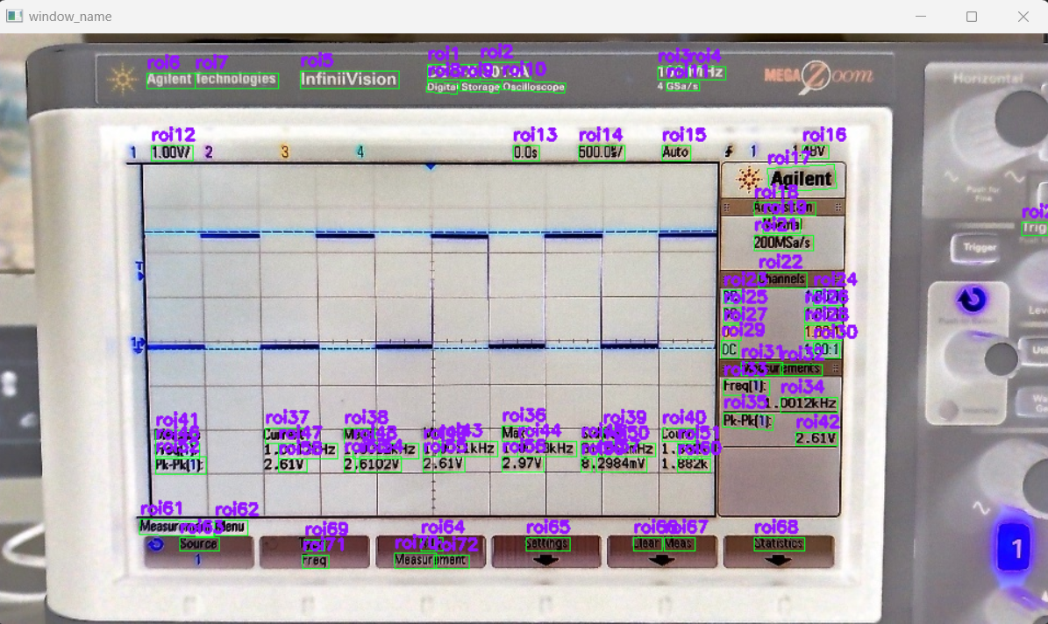
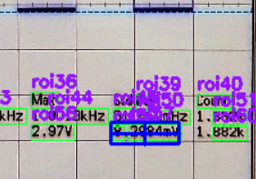
Results and implementation screenshots
ROI selection
Text Detection phase using Keras OCR

Slide 12
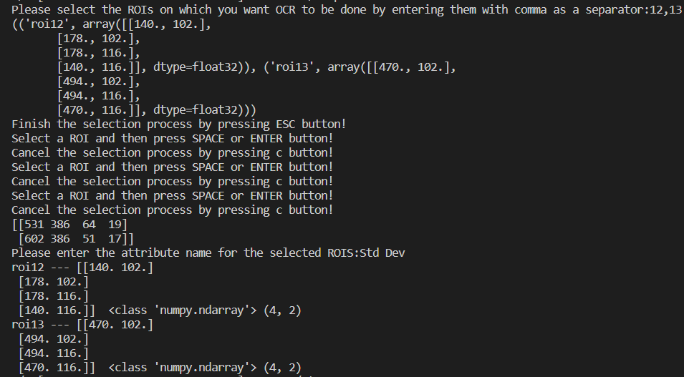
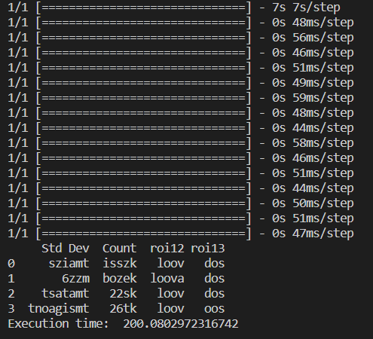
Results and implementation screenshots
Final OCR Result on Keras OCR

Slide 13
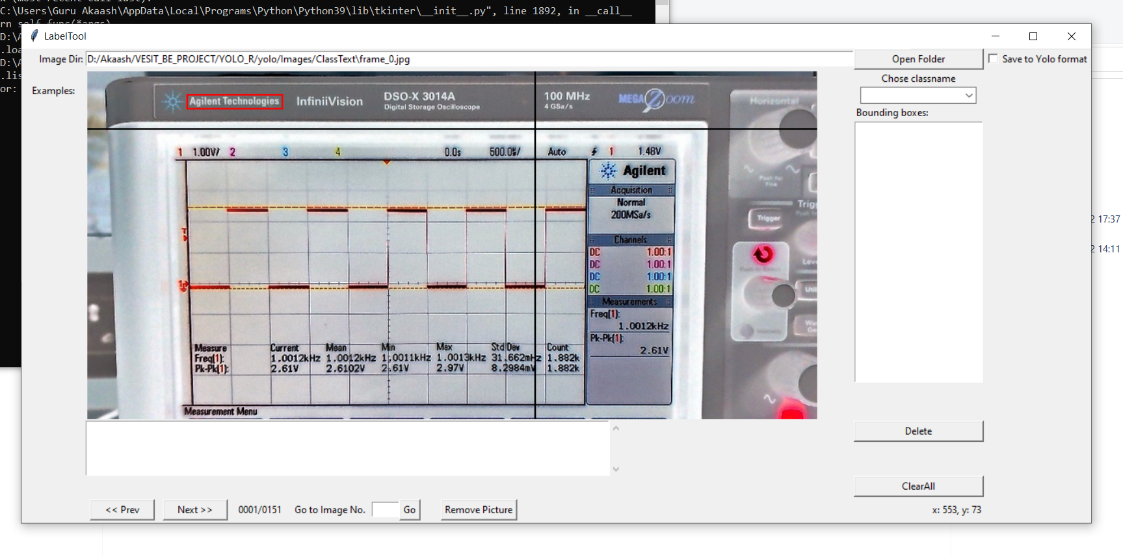
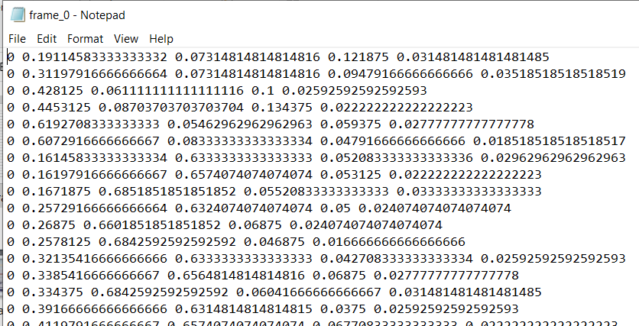
Results and Implementation screenshots
BBox Annotation Tool used for Object Annotations
YOLO Format

Slide 14
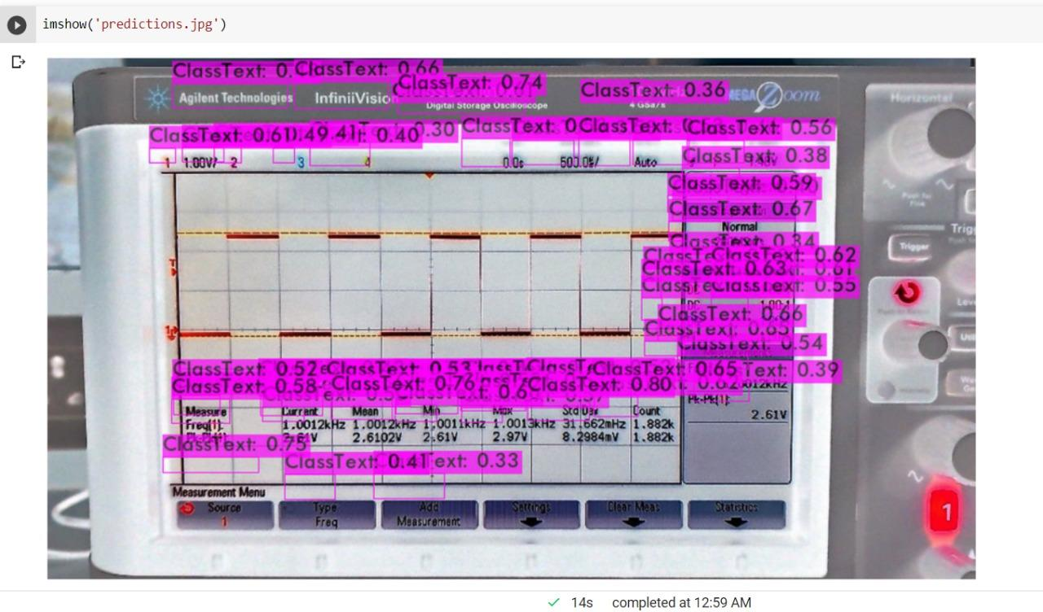
Results and Implementation screenshots
YOLO v4 Model Implementation for text detection, trained on custom dataset

Slide 15
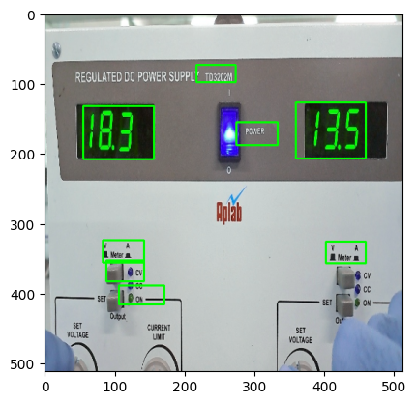
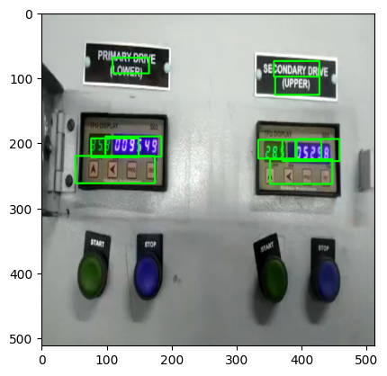
Results and implementation screenshots
MobileNet V2 Text Detection

Slide 16
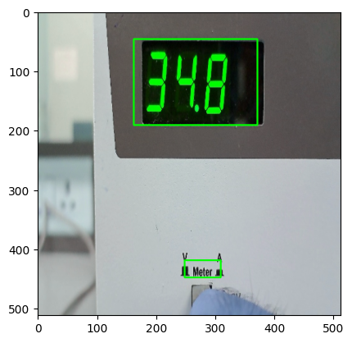
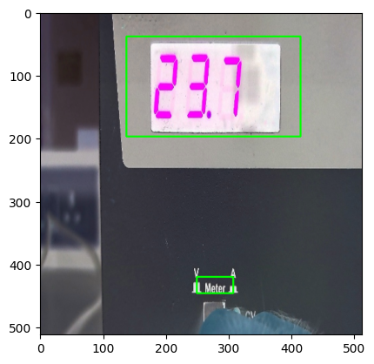
Results and implementation screenshots
Text Detection Results using MobileNet V2 Architecture

Slide 17
Conclusion
Numerous problems were faced when applying OCR on an entire frame from the video sample.
So, text detection was employed before selecting ROIs to provide better user experience on Keras and EasyOCR models and to deal with above problems.
Other OCR engines like PaddleOCR and Tr-OCR were also implemented and studied.
All python files made till now were migrated to Linux OS.

